Slide 1
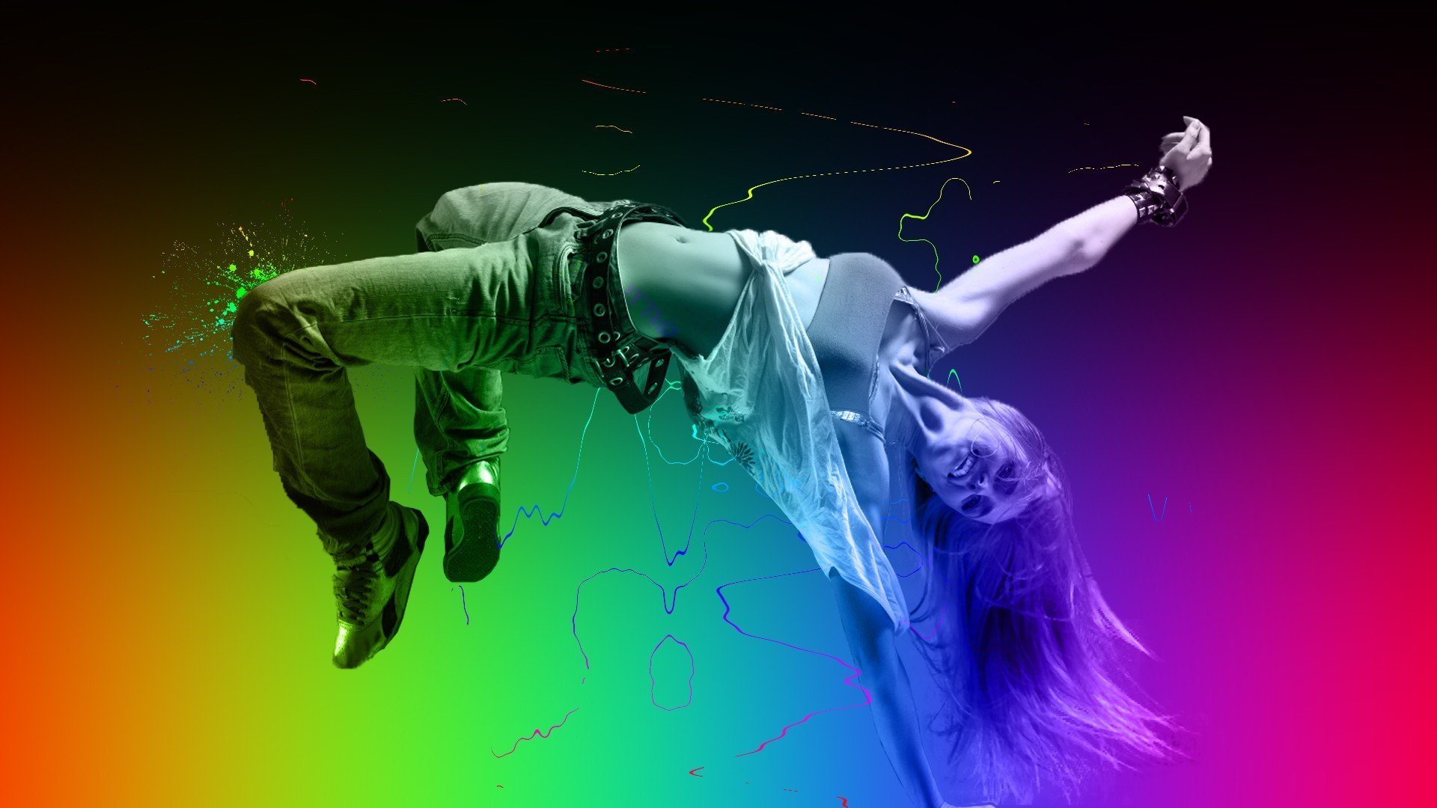


1 S T E P
By Lucy Gardener

Slide 2
Contents
Proposed Designs
Home Page
UI considerations
Classes Page
Contact Us Page
Mobile Pages
Content Management System/Admin Controls
Technical Details
Legal requirements
Timeframe for website
Pricing
Questions
References
Project Proposal
Target Audience
Client Demands
Mood Boards
Website Hierarchy
Technical Considerations
Dynamic vs Static Sites
Accessibility
Ways to Implement Accessibility

Slide 3

Project
Proposal

Slide 4
Target Audience
1 STEP are a premium contemporary dance studio offering a tuition and training in traditional ballet and abstract dance.
1 STEP offers daily classes, as well as owning a dance studio that individuals and groups can also hire.
Because of this most of the websites main visitors tend ot be professionals; guest shows and groups.
The company do market themselves as a high-end brand, and provides leading facilities.

Slide 5
Client Demands
As 1 STEP are a high-end premium contemporary dance studio, and they have professional clientele they would like their site to:
Be professional
Include links to common social media
Must be responsive so it works on a lot of different devices

Slide 6
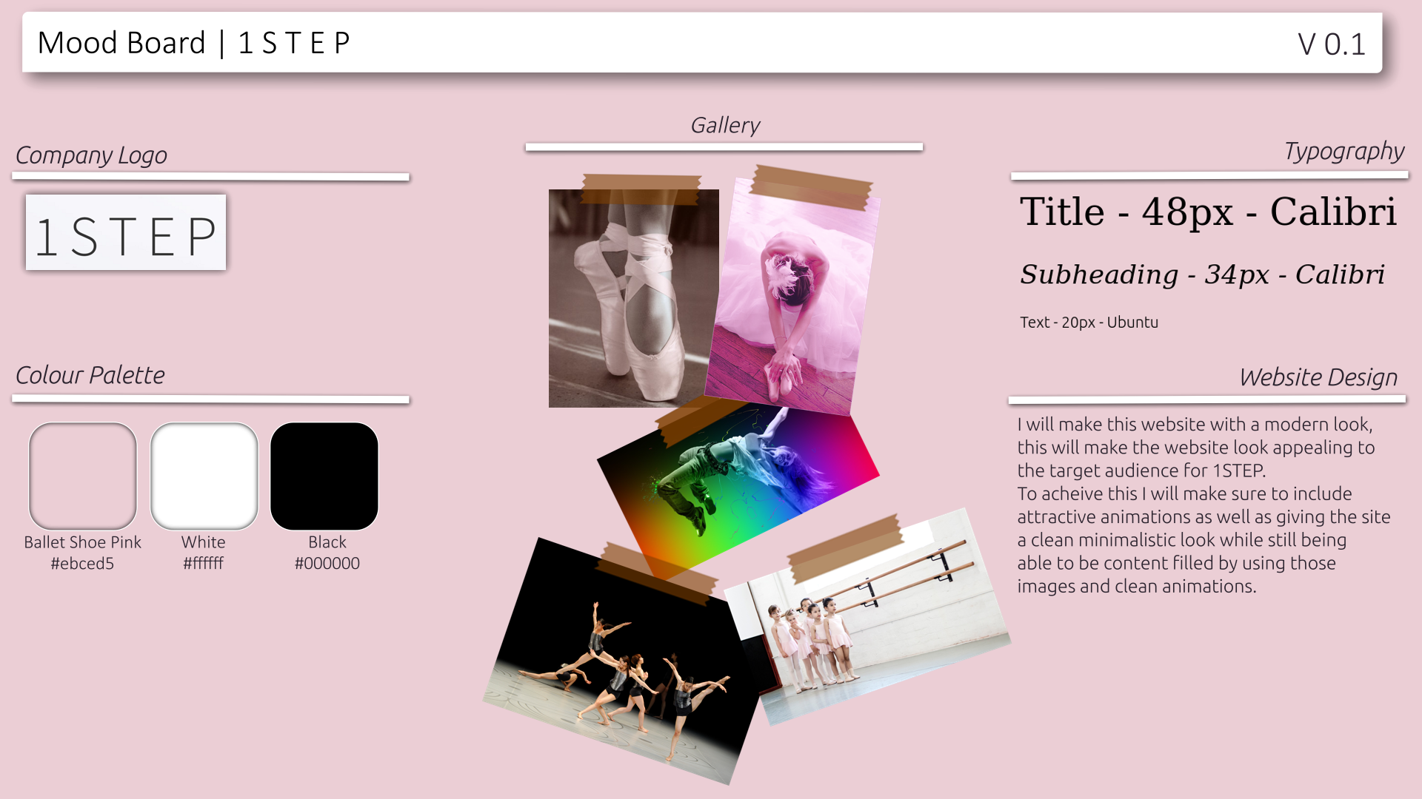
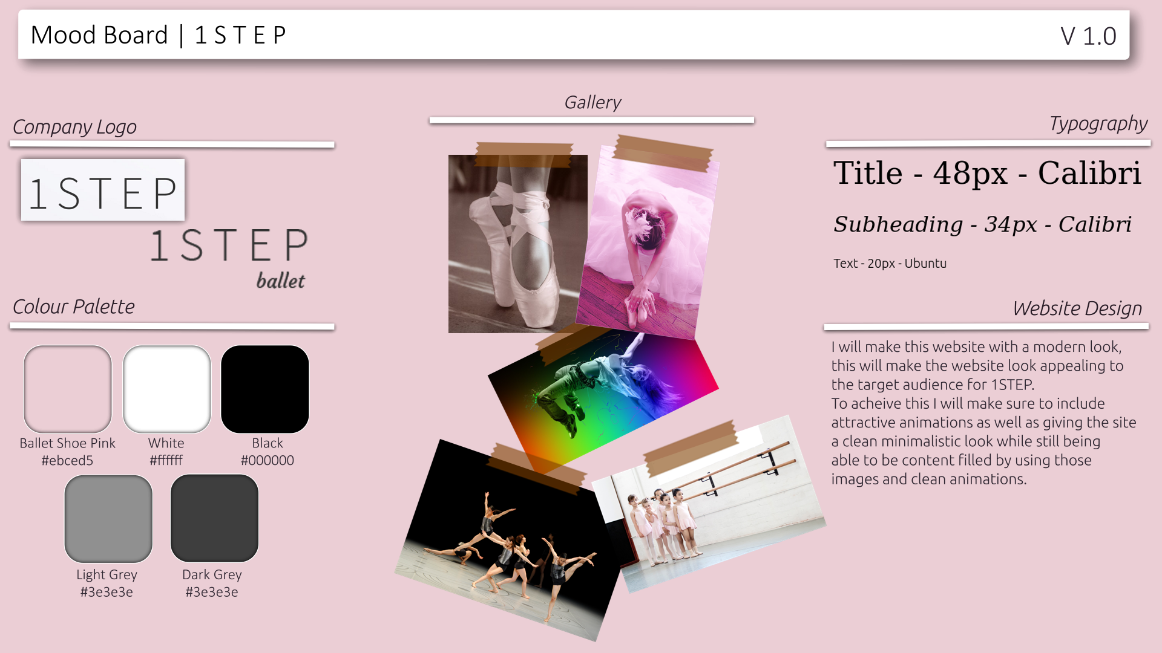
Mood Boards

Slide 7
Website Hierarchy
Home
Classes
Contact Us
Gallery
About
Admin Login
User Management
Content Management

Slide 8

Technical
Considerations

Slide 9
Dynamic vs Static Sites
Dynamic websites are “database-backend sites with dynamically generated content” (O’Reilly, 2007, p.18)
This means that all/some users can see different data/information on the site. This can be dynamically updated and (relatively) easy to change/update by admins
However, a static a static site consists of HTML pages, documents and media which can be read by the server from persistent storage and served to the client (usually a web browser) without further customisation.
No runtime changes or other operations are done to the stored page by the server. (Petersen, 2016, p.7)

Slide 10
Dynamic vs Static Sites - Benefits
Dynamic site benefits:
Faster write speeds (In terms of updating)
Real-Time and personalised content
Static site benefits:
Page load time
Efficient Scalability
Availability and security
(Petersen, 2016, p15-17)

Slide 11
Accessibility
Accessibility is a very important thing to consider when building a website.
In 2020, an estimated 43.3 million (95% UI 37.6–48.4) people were blind (Bourne, R. et al. 2019, p.140)
And colour blindness is a common problem that affects around 1 in 12 men and 1 in 200 women (nhs.uk 2019)
You want anyone to be able to access/use your site and that means you have to make it accessible even if they have disabilities or impairments that could make it difficult for them to be able to use the web
As said in the book a book about web accessibility (Rutter, R. et al., 2006 p.2) “Web accessibility means that people with disabilities can perceive, understand, navigate and interact with the web.”
Web accessibility is about removing those barriers so that everyone can use and contribute to the web (Rutter, R. et al., 2006 p.2) or someone's website.
While it is very important to include things in your site to be able to make your website more accessible it is also important to remember that people will have a lot of tools already to help them so it is better not to over-engineer anything, while at the same time making it easy for those devices to do their jobs.

Slide 12
Ways to Implement Accessibility
Efforts to make the web available to everyone are led by the WAI part of the World Wide Web Consortium (W3C). The W3C is an international community that develops open standards for the World Wide Web. Its membership includes governmental, non-governmental and private sector organizations. (Lewithwaite, 2014)
There are numerous ways to implement accessibility on a website.
Some examples of this stated by the article made by the W3 consortium (w3.org, 2017) are:
Easy-to-read text : This is important as it means passages of text can be easier to understand
Symbols : Icons can be used to represent words or concepts making it easier for people who find it more difficult to read or write
Reduced interface : only shows content that is relevant and not repeated, can also hide content that could distract users
Customized fonts and colours : Changing the font types, sizes and colors, and spacing to make text easier to read.
Consistency and predictability : labelling of functions such as links, buttons and controls should be consistent and the expected function should be predicable from the label.
Descripting titles, headings, and labels : Page titles, section headings, and labels for forms, links, and controls are sometimes read on their own or out of context and need to be descriptive

Slide 13
Ways to Implement Accessibility
Alt Tags
Images that play some active role in the navigation of a site must have meaningful and simple alt-text. Users with disabilities will not be able to navigate or otherwise interact with your site without that text. (Rutter, R. et al., 2006 p.136)
Alt text allows a screen reader to read to a screen reader user what is trying to be conveyed on the website page According to (Rutter, R. et al., 2006 p.136) when there is not alt-text, different assistive technologies look in different places such as the src/href of an image which at time can be unreliable and not helpful for a screen reader user.
However according to (Keysers. et al. 2007, p.249) who cites (Richards and Hanson. 2004) without an alt tag when a mouse hovers over an image it will read out “Image”.
From inferring from both I think that both are possible dependent on the device used and the user’s settings, overall I believe (Rutter, R. et al., 2006 p.136) is more precise as it was made 2 years after the citing of (Richards and Hanson. 2004) And was very accurate with recording what screen reader device would do what.

Slide 14
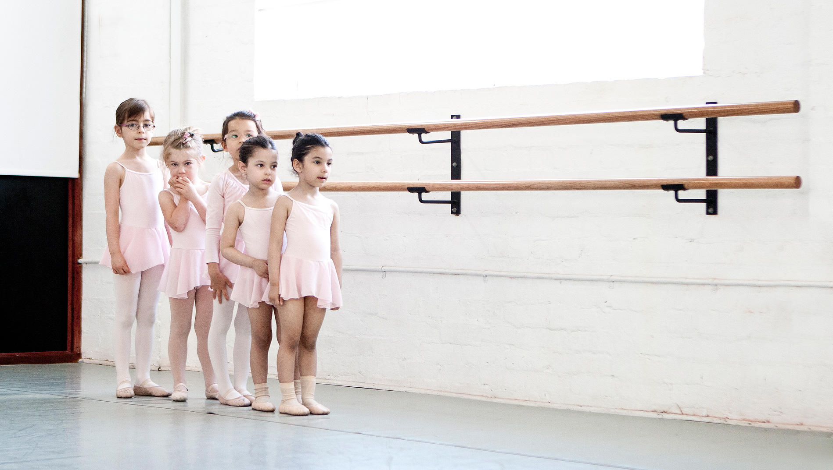
Proposed
Designs

Slide 15
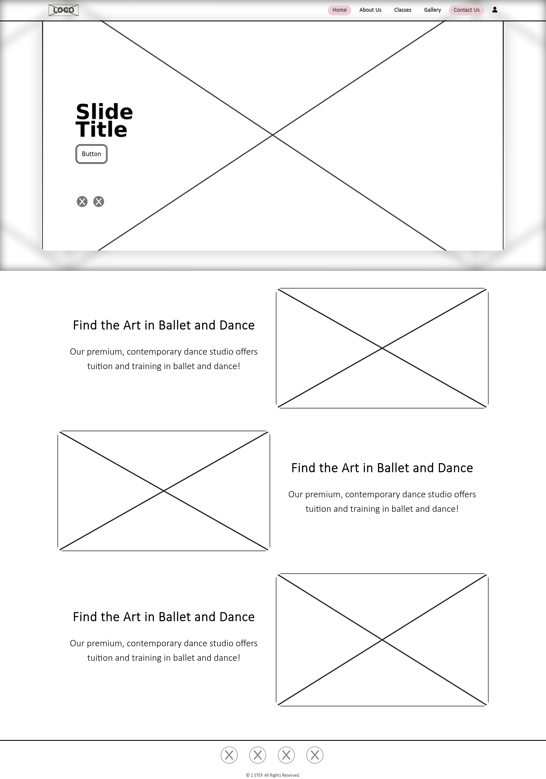
Home Page - Nav Bar
Logo space, this is where the 1 STEP logo will go in the nav bar
This nav-bar will be used on every page
The nav-bar content should be easy to access and has a visual cue to show which page you are on and which one you are hovering over by changing color, this has a little animation.
The navbar is fixed to the top at all times meaning that it should always be able to access by all users, it also has a blur effect so that it’s content can be seen easily

Slide 16
Home Page - Slider
The slider can have many different slides which can be amended/changed using the content management system. Each slide will have a heading and a button to direct users to where they might want to go
The slider has 2 buttons to choose between slides that a user wants to go, however will also automatically change every so often so users will see something different as they watch.
The slider will show the image given however also create a blurred version of itself behind it to give a nicer effect

Slide 17
Home Page - Main Content
In the main content of the home page some brief descriptions of what 1 STEP stands for / provides can be represented using some basic headings and a little bit of text.
This allows to simply reel in the target audience and get the captivated while not overloading information
Next to text there can be images which can be changed just like the text using the content management page.
The images can provide a nice contrast to the text and can also be used to provide more information while not having a user read a lot of text.

Slide 18
Home Page - Footer
This footer will be used for every page as it allows for consistency allowing every page to be consistent.
This footer allows users to also find all social media links meaning they will also be on every page.
The footer also allows for a copyright to be added to the bottom of the page. This can be amended in the content management page if it is needed to be changed or updated.
Using the content management tool, social media links can also be added or removed.

Slide 19
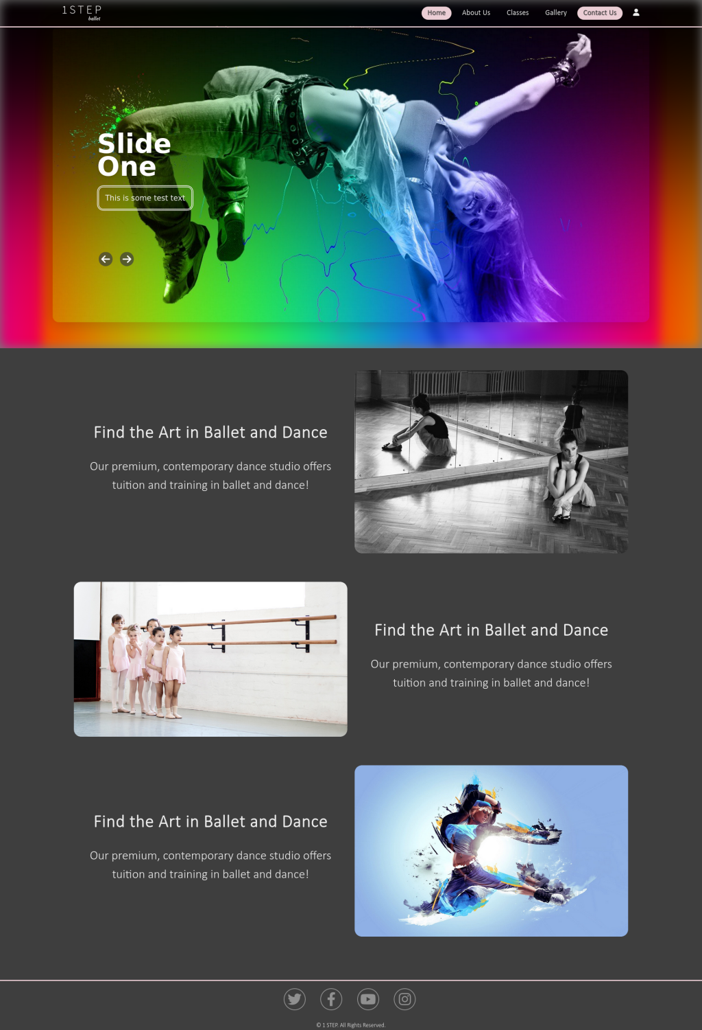
Home Page - Final look

Slide 21
UI considerations
When making the overall theme for the website design some things that were considered was the colour pallette and rounding on images.
It was decided to use a dark theme, this is because dark themes are supposed to allow for a more comfotable user experience (Eisfeld, H, 2020, p.ii) which might be key for improving the usability of the site for the professional clinetelle that 1 STEP’s target auidence is.
Another thing that was decided was to round the corners of images, buttons, and any other sharp-cornered element, this allows the images to appear less bright and be easier on the eyes. (uxmovement.com, 2021)

Slide 22
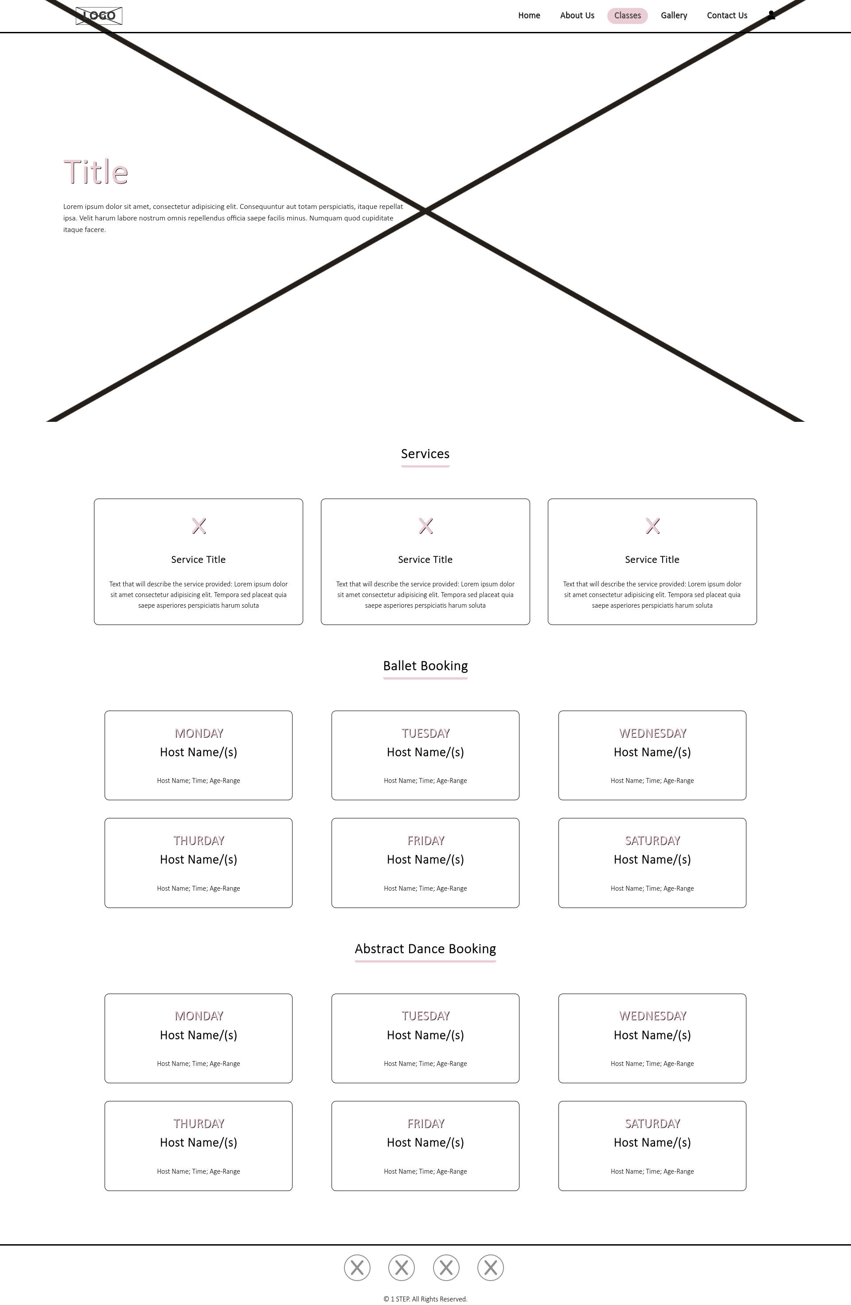
Classes Page - Load In view
In the background at the
top of this page is an image to help improve the appearance of the page and show users more things that 1 STEP provide.
There is a title and text on top of the image, this allows some text to be used to describe this page and introduce itself to more professional clients.

Slide 23
Classes Page - Main Content
On the front page the website will show the different services that 1 STEP provide such as: Renting of studios, ballet and abstract dancing.
More can be added, removed or even amended using the content management page as well as including images to help indicate what they are.
Booking will also be here on this page, a description will be shown for users to see which days can be booked as well as which tutor will be on that day and the times.

Slide 24
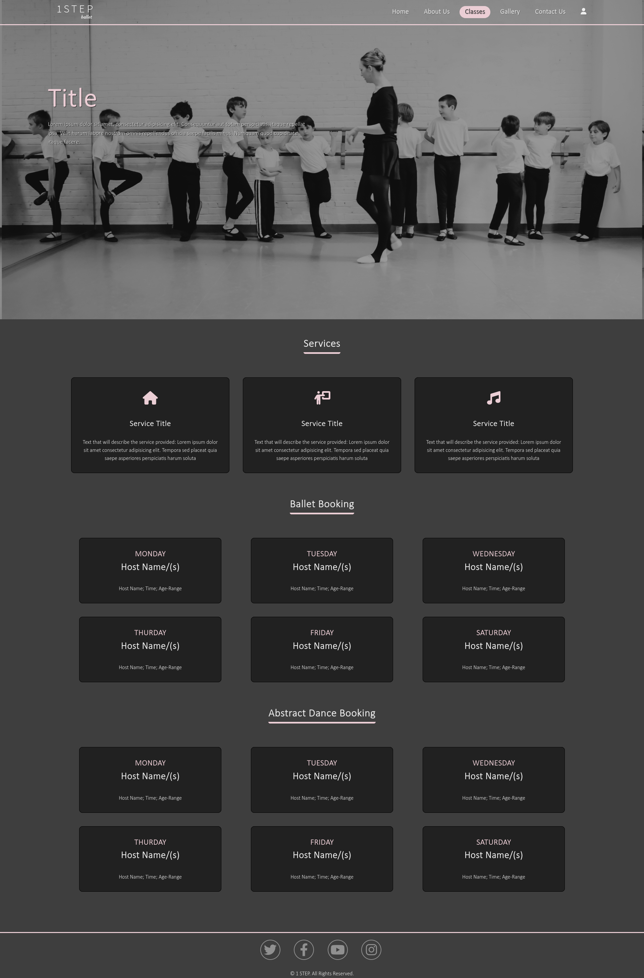
Classes - Final look

Slide 26
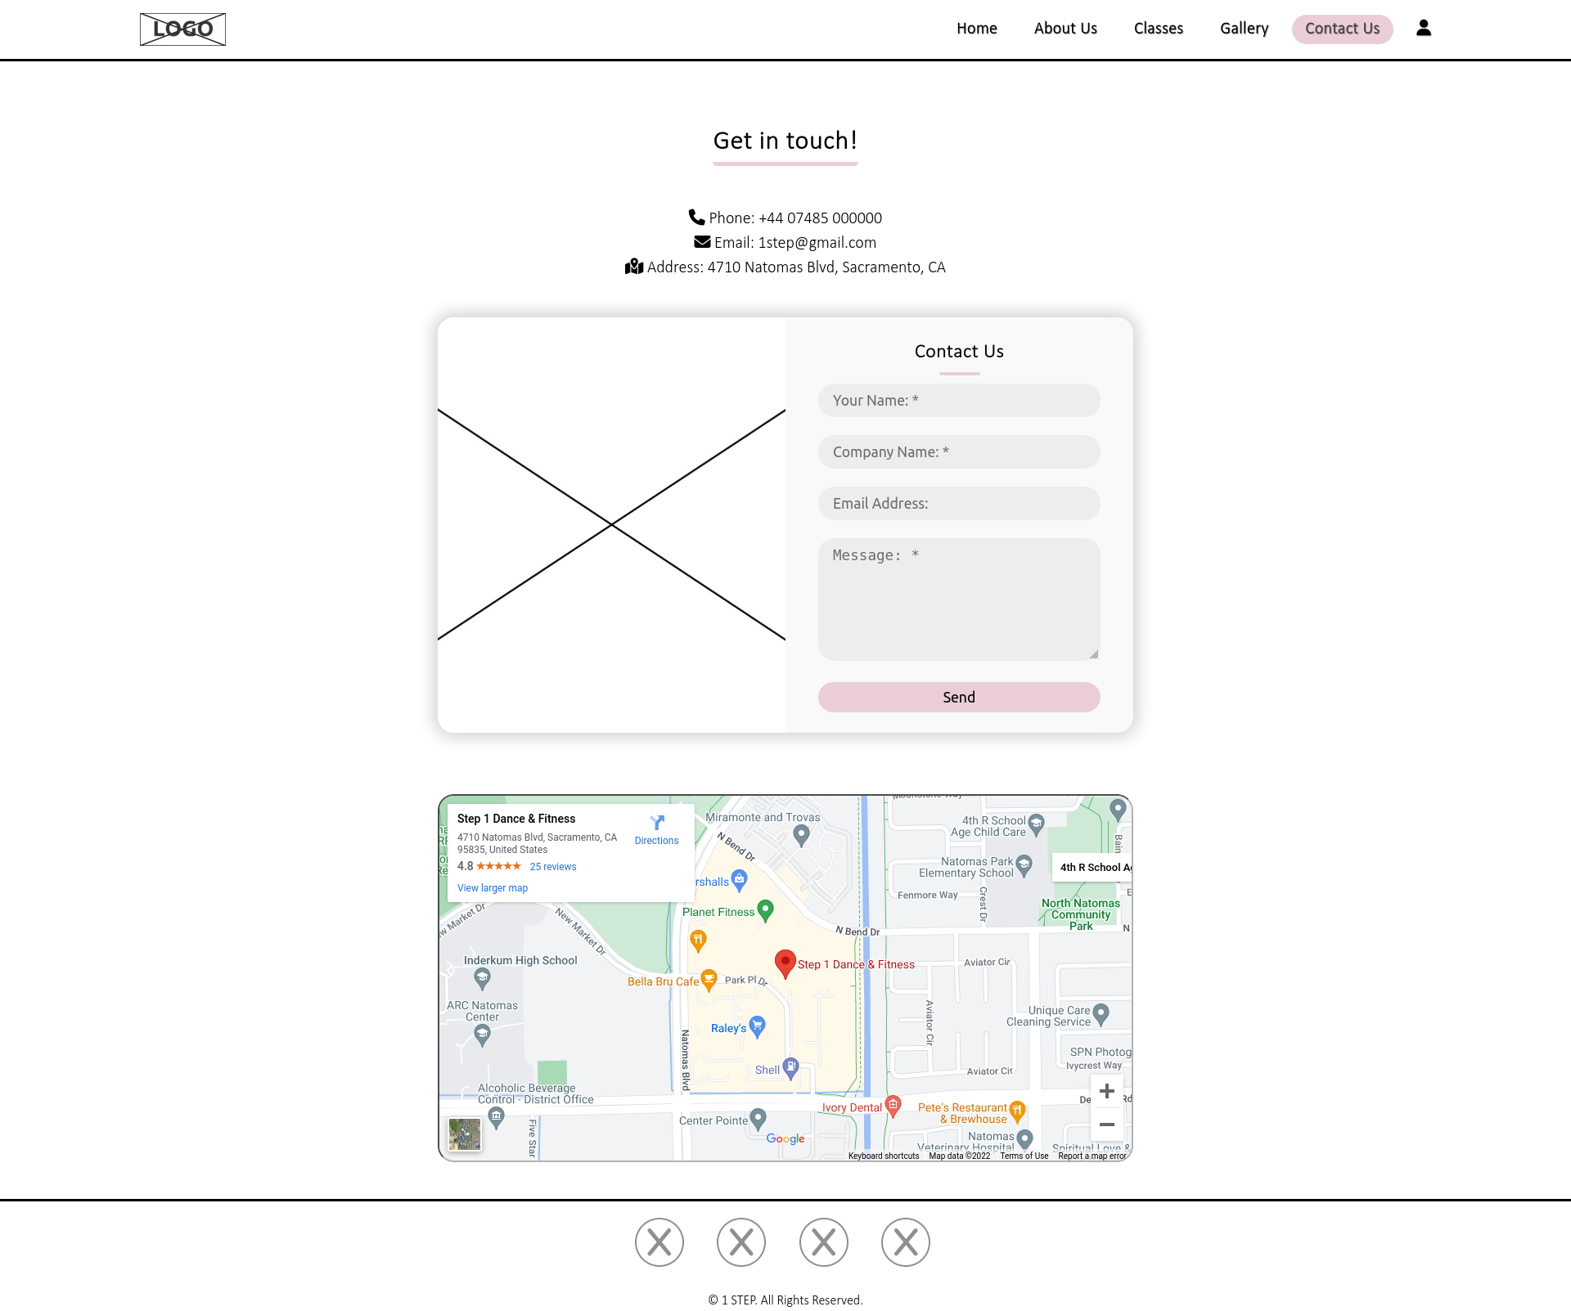
Contact Us Page - Main Content
As well as the contact information there is also a contact form which a user can use as well as a google map which is embedded which means users can see the location and use it to get directions to 1 STEP or save the location on their google account.
On the Contact page the first section to see is the information that people can use to contact 1 STEP, there is a number, email and the address, this makes it easy for someone to find how to contact them.

Slide 27
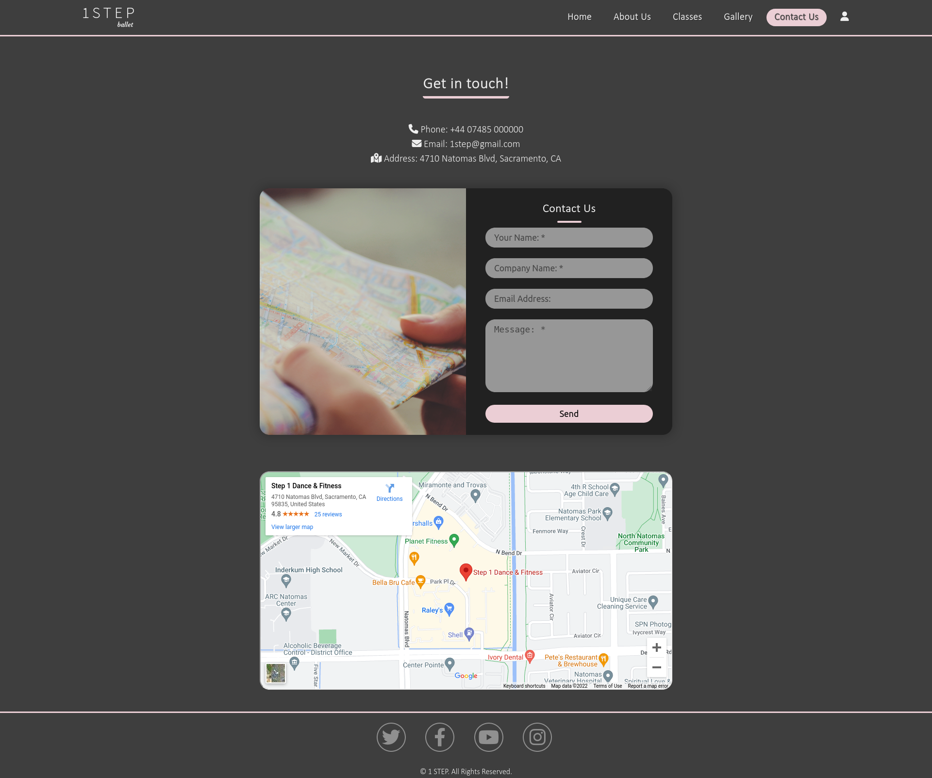
Contact Us Page - Final Look

Slide 29
Mobile Pages - Navbar
When going to a mobile device, or a device with a smaller width the navbar will shrink getting rid of the navigation tabs and change it into a hamburger menu.
This allows mobile devices to access it easier and be able to be more accessible.

Slide 30
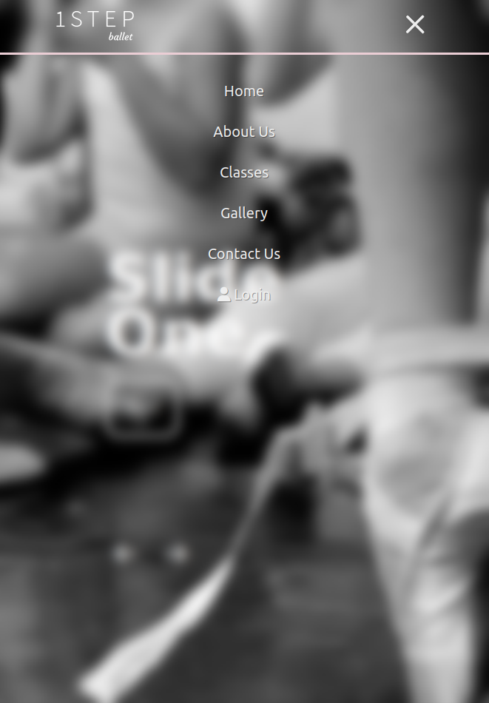
Mobile Pages - Navbar
When pressing the hamburger menu it will open the menu which is a full page screen that goes on top of the page with an animation scrolling in from the top and blurs the background
The text on the menu when touched or hovered over adds the ballet pink colour as a background and turns the text black.
When the hamburger menu is opened the hamburger menu will turn into an X which if pressed again will then close the hamburger menu.

Slide 31
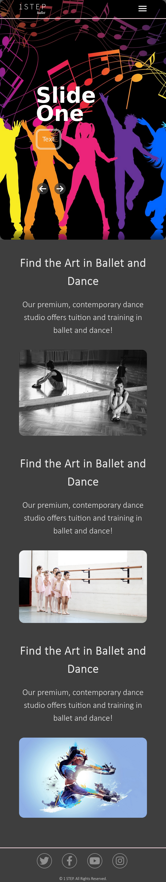
Mobile Pages - Home - Slider
On the home page the slider is still present in a mobile view however some changes are made:
The main image will fill the whole page rather than a little bit of it and having a blurred version behind it.
The photo also loses the sides and focuses more on the middle.

Slide 32
Mobile Pages - Home - Main Content
In the mobile version instead of text and images being on alternating sides the text and images get laid out so the text will be on the top and then the image related to that will be underneath.
This allows users of the webpage to be able to still read the text and images while on a smaller device

Slide 33
Mobile Pages - Home - Final Look

Slide 34
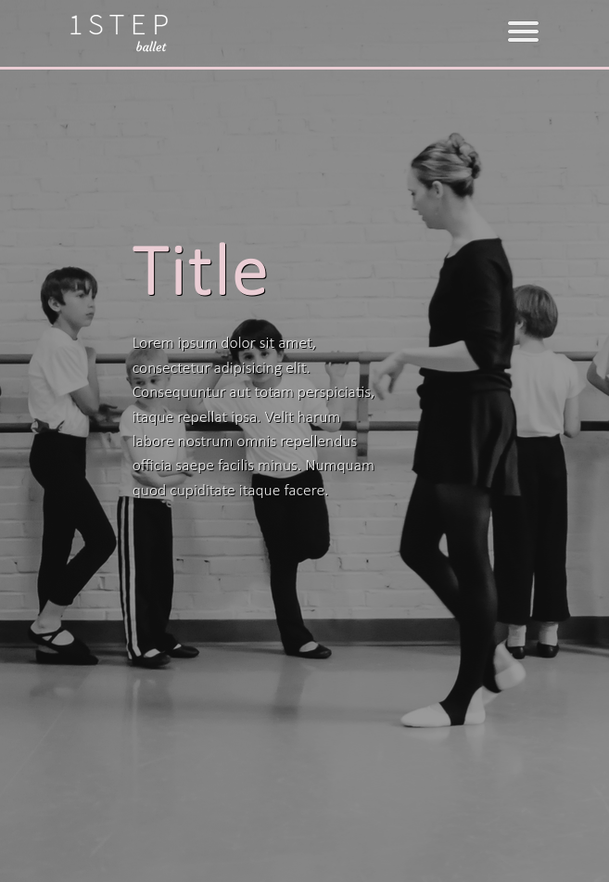
Mobile Pages - Classes - Top
With the top of the classes page, the image remains keeping 100% height of the page, however not all of the image width is shown.
The text stays color the same percentage width and moves in.

Slide 35
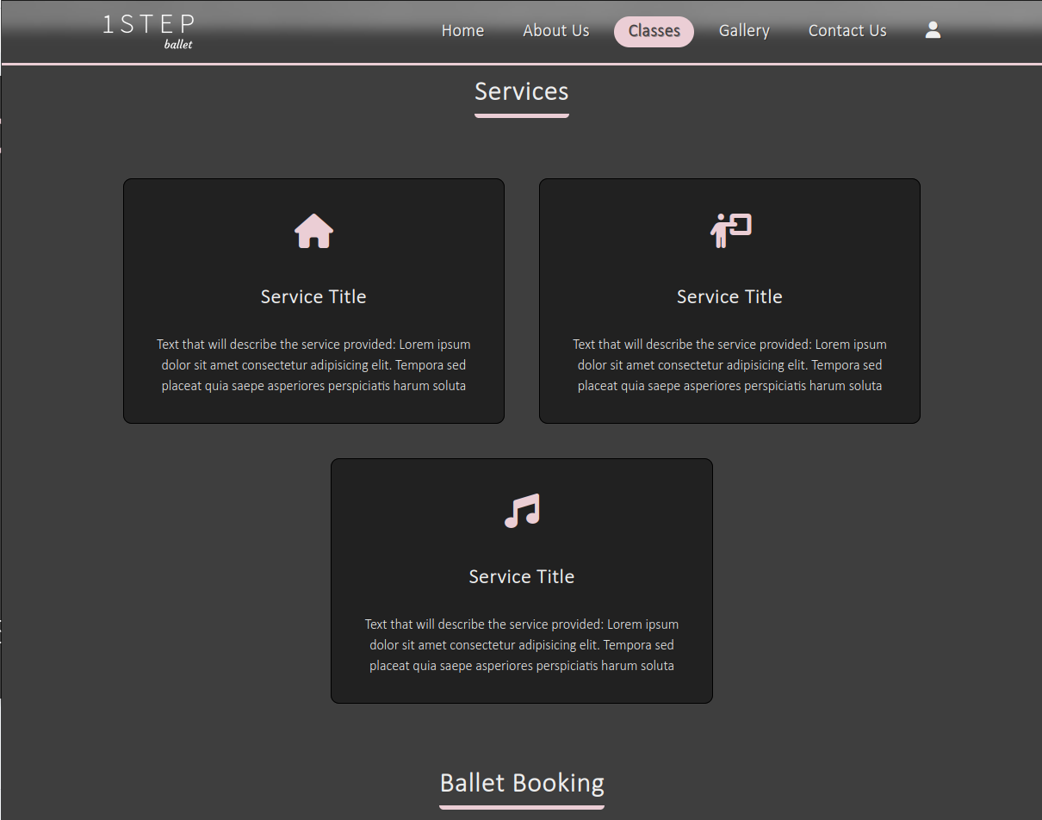
Mobile Pages - Classes - Services

Slide 36
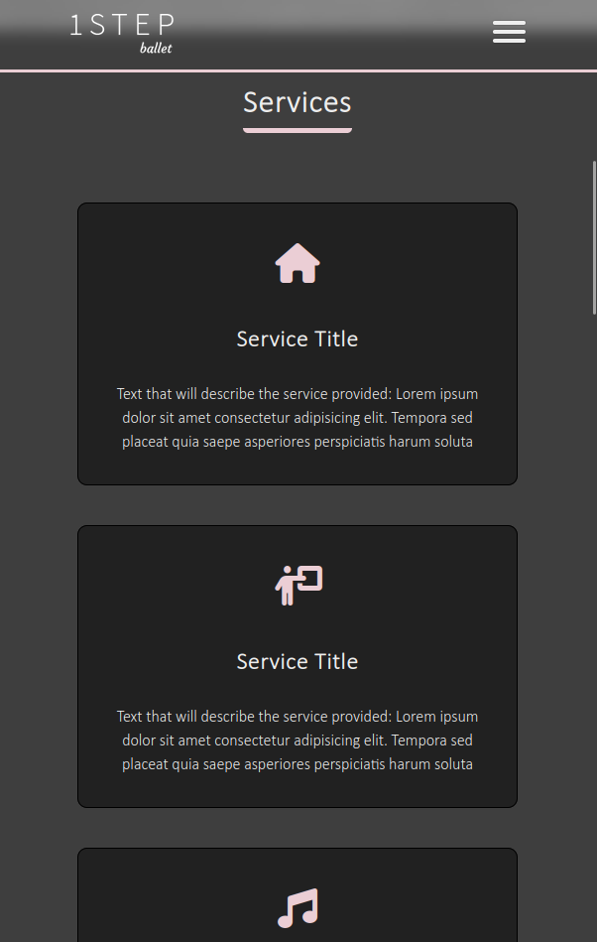
Mobile Pages - Classes - Services
As the device gets smaller at different sizes the service boxes will change to different widths and take up more or less space depending on the size of the screen.

Slide 37
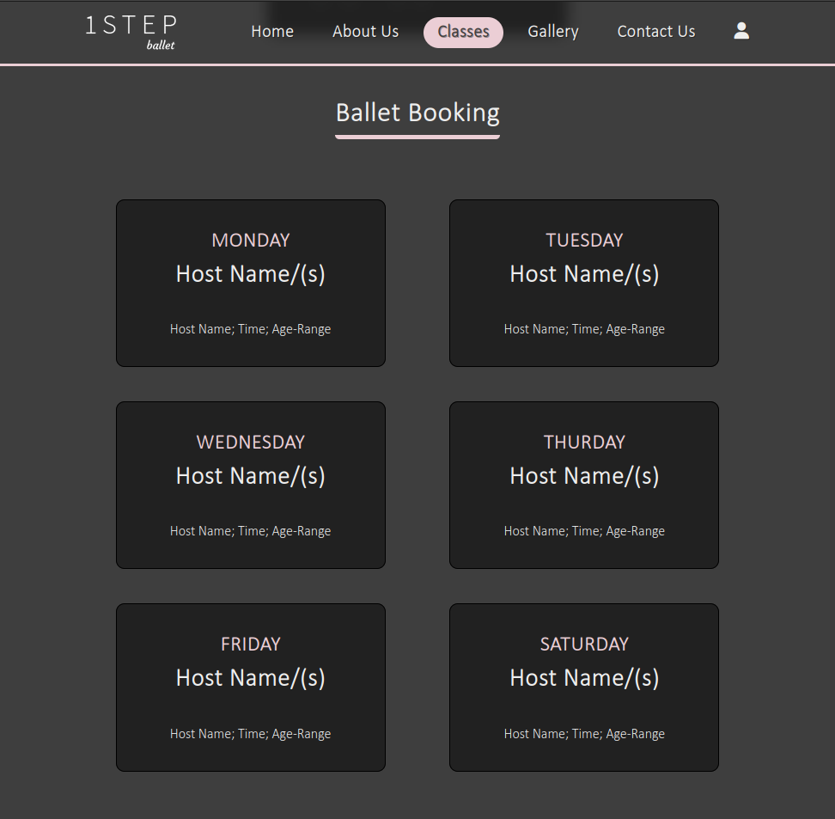
Mobile Pages - Classes - Timetables

Slide 38
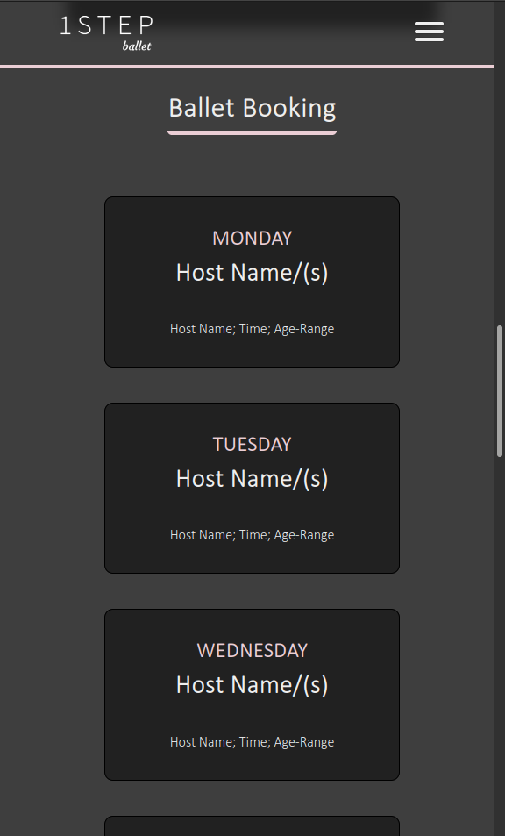
Mobile Pages - Classes - Timetables
Just like with the services section the classes booking will shrink the size of each element to make them fit on the page and make it better for mobile users

Slide 39
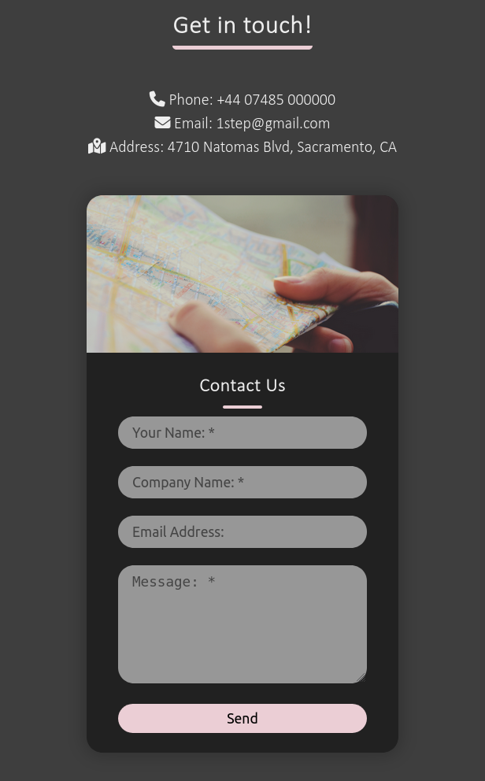
Mobile Pages - Contact Us
The contact form changes the image from the side to the top, this allows the image to still be viewed.

Slide 40
Content Management System/Admin Controls
Some form of content management (CM) process or system is becoming essential for all organisations with a significant Web presence as the amount of digital content continues to proliferate Such systems help a business to set‐up and organise their Web site(s), so that the Web sites can grow and change rapidly while maintaining high quality (Susan, M. 2003 p.686)
The content management system will only be able to be used by an admin user, to do this they have to log into an admin account that is accessed the same way people can log into their accounts.
When in the admin account they can access a form of the website in which all text parts when hovered over can be edited, this means that it is easy to be able to change the content.
However for bigger edits like adding/removing services or booking dates or even images to the slider can be changed using a more complex content management system.

Slide 41
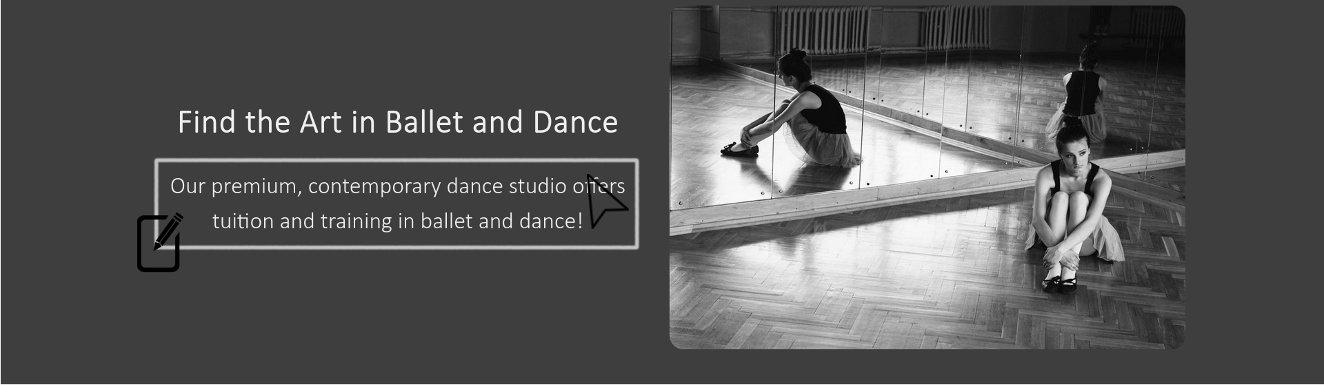
Content Management System/Admin Controls
As you can see here as the cursor hovers over some text, a box will go over the text to edit it and an icon will appear at the bottom right to show it can be edited, by tapping on it a text area will come up where an admin can edit the text

Slide 42
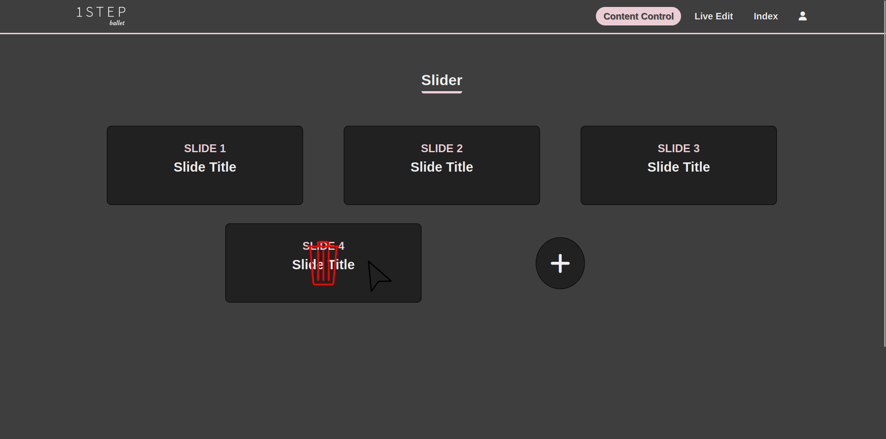
Content Management System/Admin Controls

Slide 43
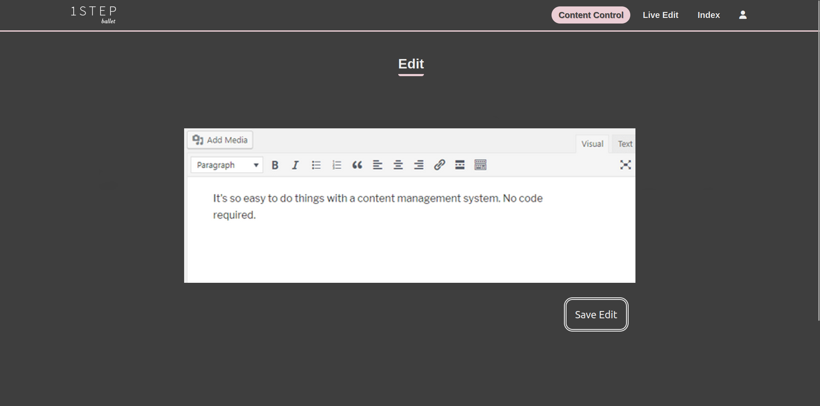
Content Management System/Admin Controls

Slide 44
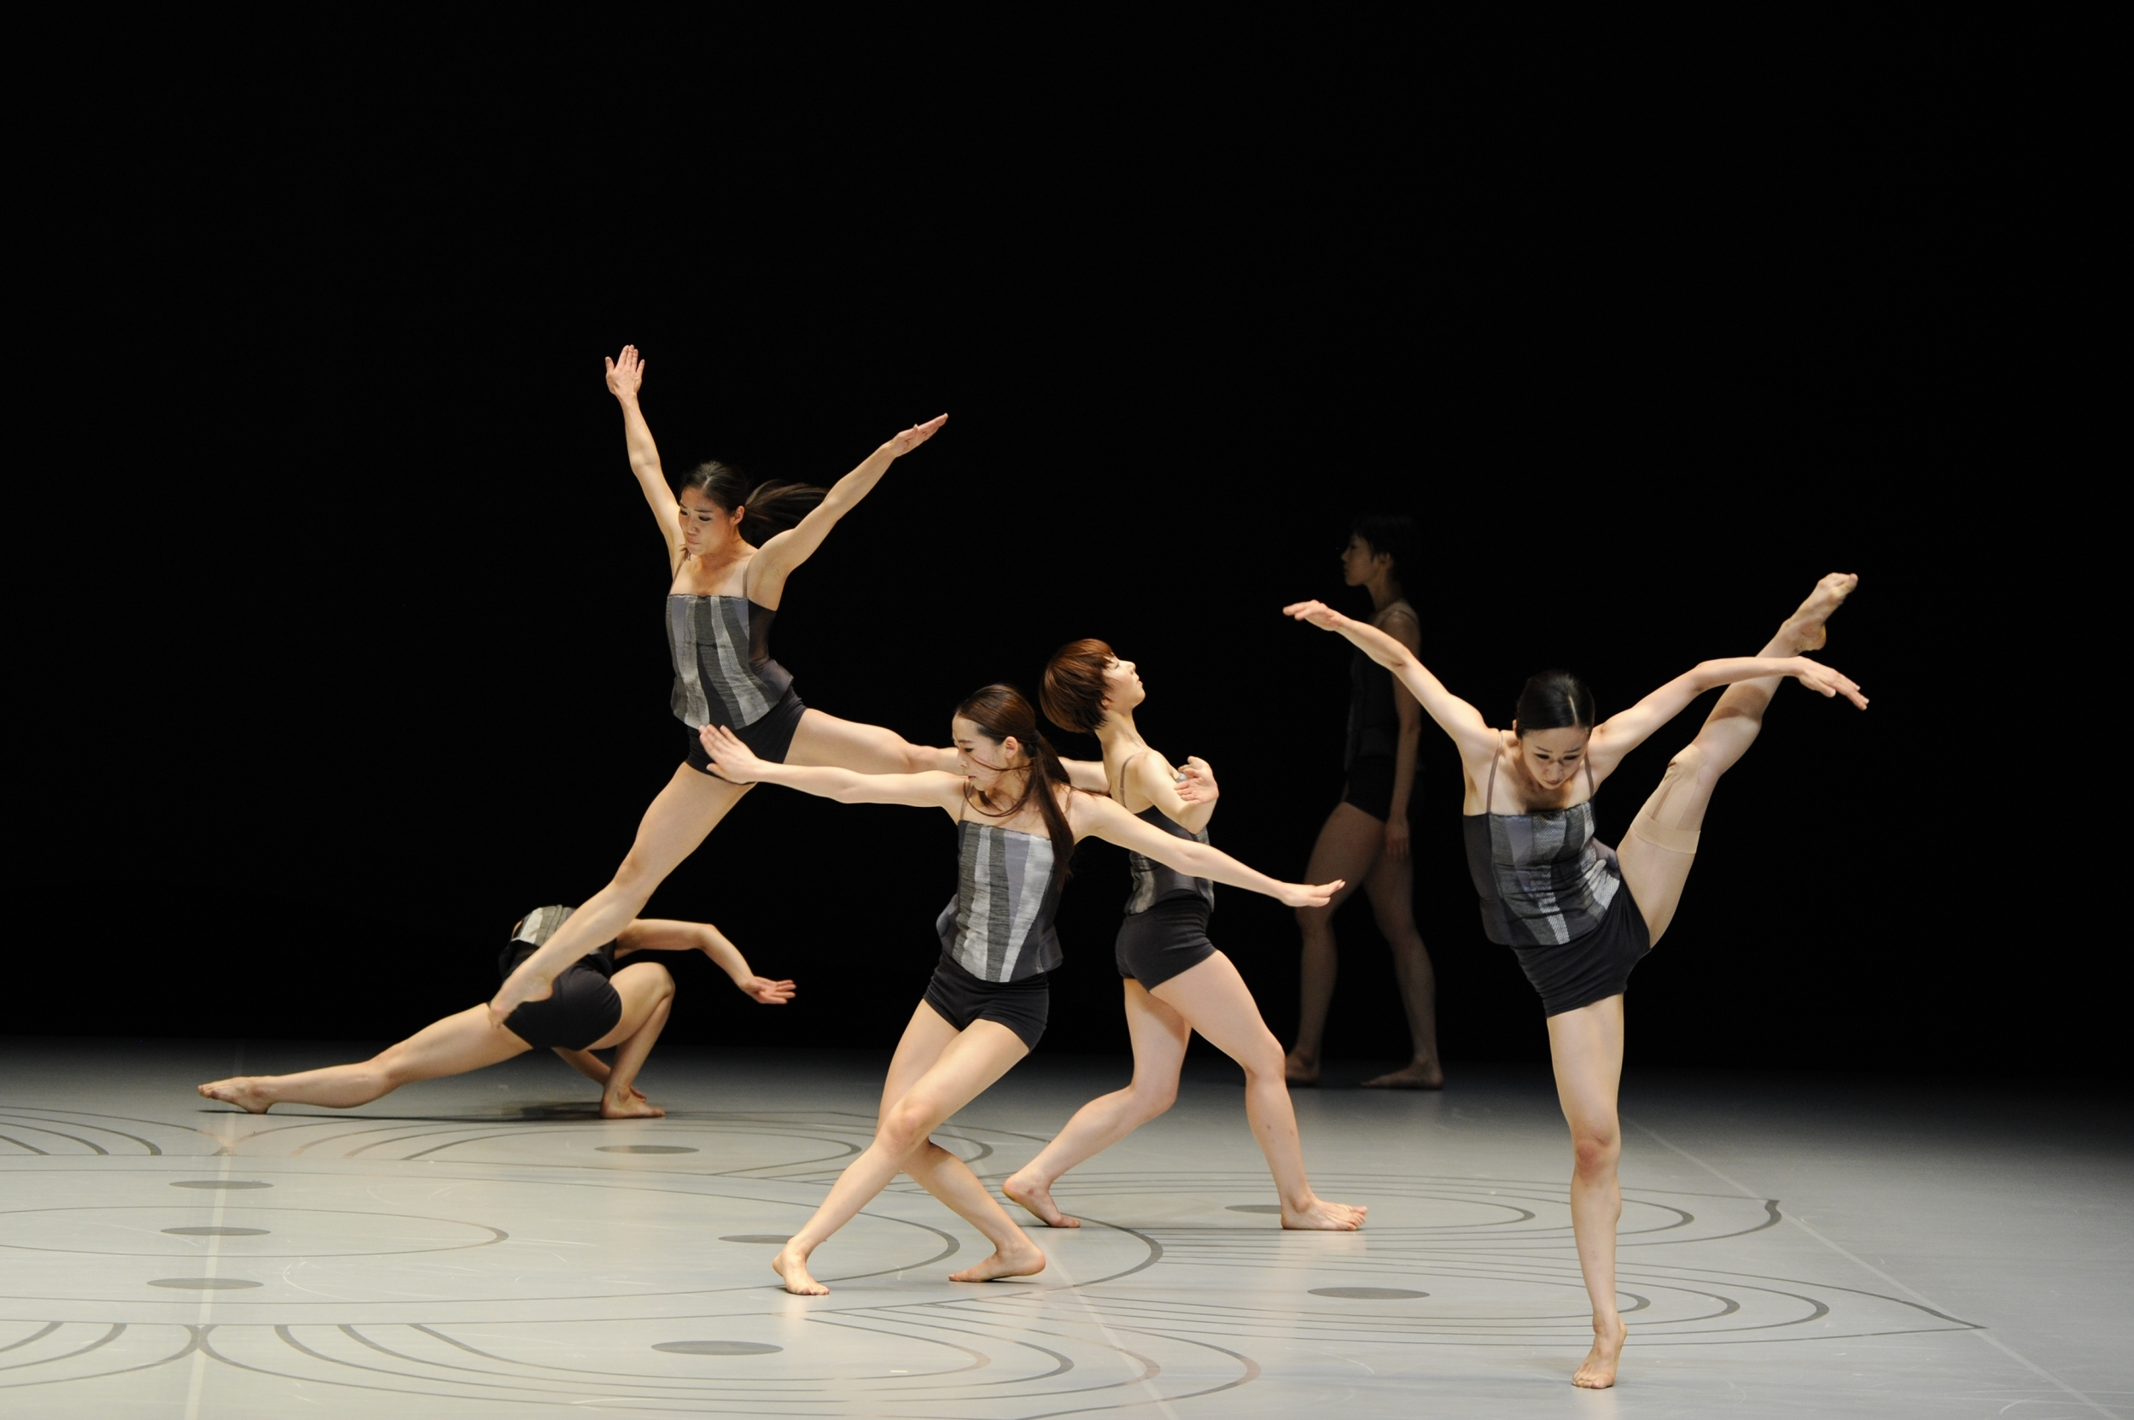
Technical
Details

Slide 45
Legal Requirements
According to the GOV.UK “If you created a new public sector website on or after 23 September 2018, you need to meet accessibility standards” (gov.uk 2018) this means that the website must include the accessibility features to ensure that almost any user must be able to use a website. This includes people with:
impaired vision
motor difficulties
cognitive impairments or learning disabilities
deafness or impaired hearing
As the site will also allow admin accounts and people to log in it is also important to remember to adhear to the UK data protection act. According to ICO (Information commissioner’s office) the 7 principals to keep in mind are: (Lawfulness, fairness and transparency), (Purpose limitation), (Data minimisation), (Accuracy), (Storage limitation), (Integrity and confidentiality (security)). (ico.org.uk)

Slide 46
Timeframe for Website
Initial Planning
10 days
Prototyping
20 days (30 days total)
Pre-Release Testing
14 days (44 days total)
Publication
8 day (52 days total)

Slide 47
Pricing
Name of cost | Price
Web Hosting | £20 a month / £240 a year
Domain Name | £10 a year
Website Development | £7,500
Ongoing Maintenance (12 months) | Free first year, £100 for each occurrence
Total | 1st year - £7,750 - 2nd - £350 (Full maintenance) £250 (No maintenance)

Slide 48

Questions

Slide 49
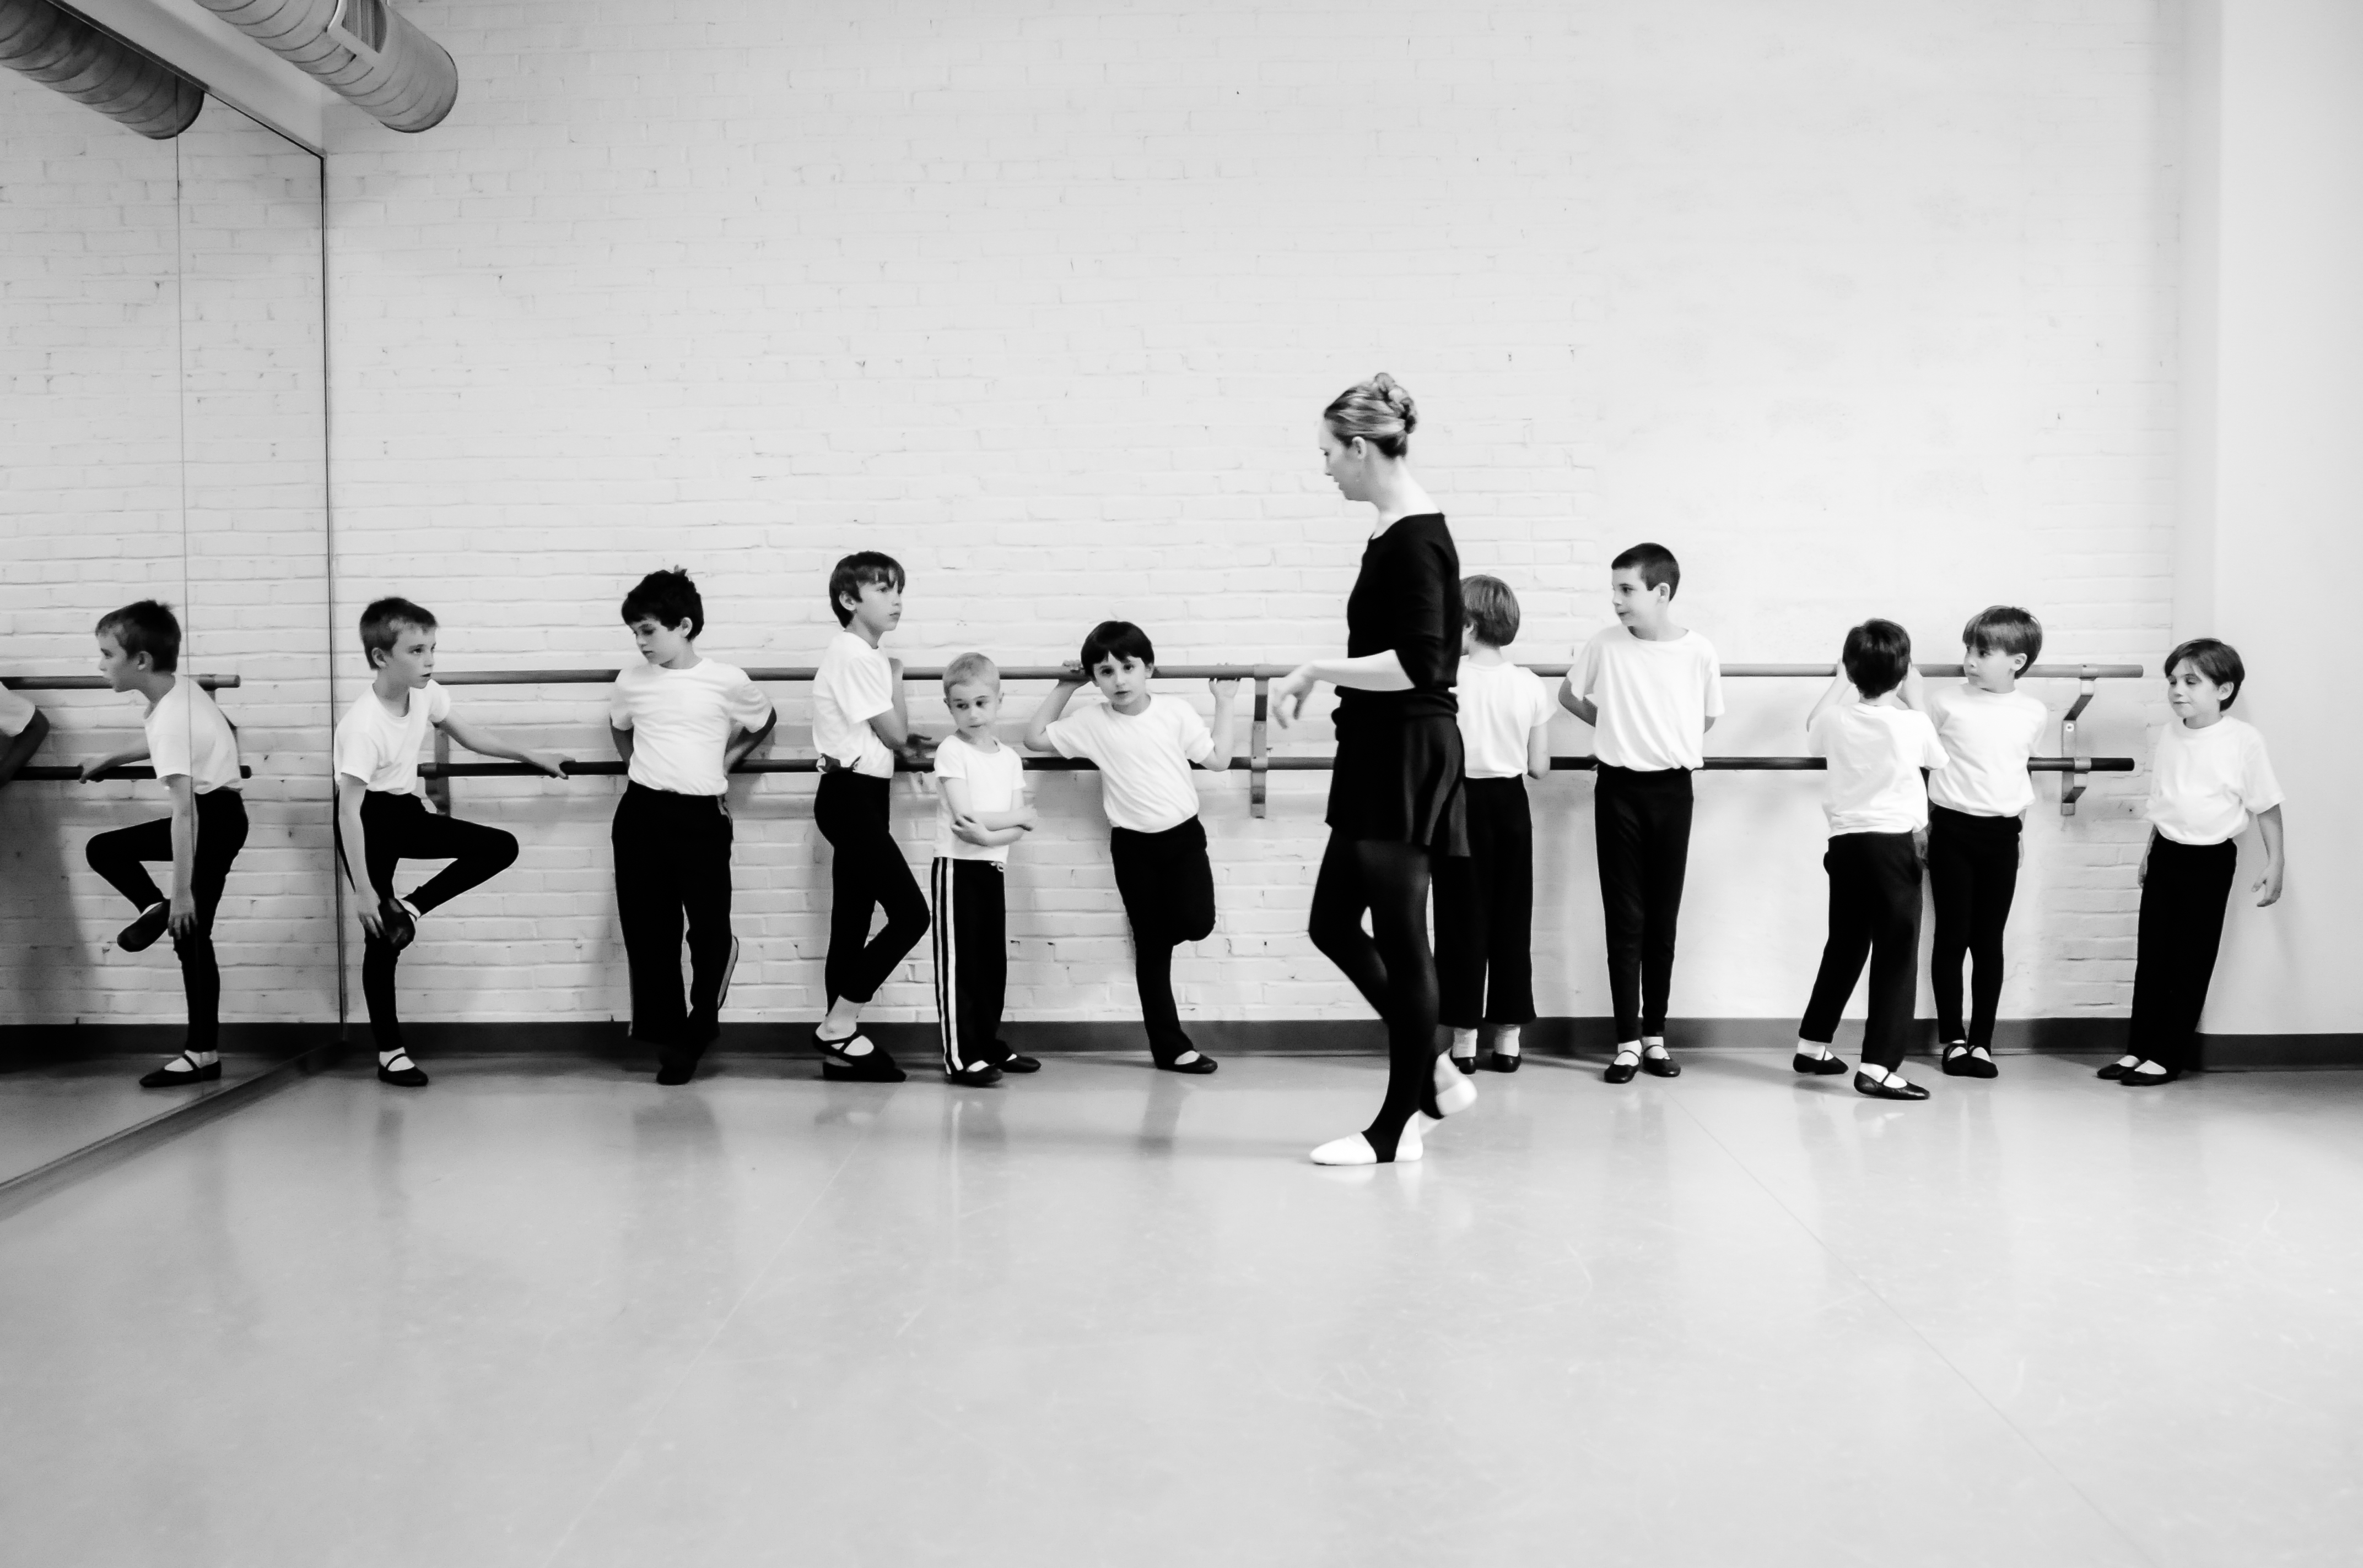
References

Slide 50
O’Reilly, T. (2007) What is Web 2.0: Design Patterns and Business Models for the Next Generation of Software [online]. SSRN: O'Reilly Media, Inc. [Accessed 18 11 2022].
Rutter, R. et al. (2006) Web accessibility web standards and regulatory compliance. Berkeley, CA: Apress. [Accessed 18 11 2022].
Tools and Techniques (2017) w3.org [online]. 15 May. Available from: https://www.w3.org/WAI/people-use-web/tools-techniques [Accessed 20 11 2022].
Hilar Petersen. (2016) From Static and Dynamic Websites to Static Site Generators. [online]. [Accessed 22 11 2022].
Sarah Lewithwaite. (2014) Web accessibility standards and disability: developing critical perspectives on accessibility [online]. [Accessed 22 11 2022]
Daniel Keysers, Marius Renn, and Thomas M. Breuel. (2007) Improving accessibility of html documents by generating image-tags in a proxy [online]. Association for Computing Machinery. [Accessed 22 11 2022]

Slide 51
Bourne, R. et al. (2019) Trends in prevalence of blindness and distance and near vision impairment over 30 years: an analysis for the Global Burden of Disease Study [online]. [Accessed 26 11 2022].
Colour vision deficiency (colour blindness) (2019) nhs.uk [online]. 01 April. Available from: https://www.nhs.uk/conditions/colour-vision-deficiency/ [Accessed 26 11 2022].
Guide to the UK General Data Protection Regulation (UK GDPR) ico.org.uk [online]. Available from: https://ico.org.uk/for-organisations/guide-to-data-protection/guide-to-the-general-data-protection-regulation-gdpr/ [Accessed 26 11 2022].
Susan, M. (2003) Understanding Web content management systems: evolution, lifecycle and market [online].
Industrial Management & Data Systems, Vol. 103 No. 9, pp. 686-692. [Accessed 26 11 2022]
Eisfeld, H., & Kristallovich, F. (2020). The Rise of Dark Mode : A qualitative study of an emerging user interface design trend [online]. [Accessed 26 11 2022]
Why Rounded Corners Are Easier on the Eyes (2011) uxmovement.com [online]. 17 August. https://uxmovement.com/thinking/why-rounded-corners-are-easier-on-the-eyes/ [Accessed 26 11 2022].
Understanding accessibility requirements for public sector bodies (2018) nhs.uk [online]. 09 May https://www.gov.uk/guidance/accessibility-requirements-for-public-sector-websites-and-apps [Accessed 26 11 2022].

